Slide 1
Amazon Alexa on coldfusion
MMCFUG - 2017

Slide 2
Ground Rules

Slide 3
Agenda
About the Amazon Alexa
Basics of building and Alexa Skill
Basic Voice Response Demo
Voice Response Demo with a Slot

Slide 4
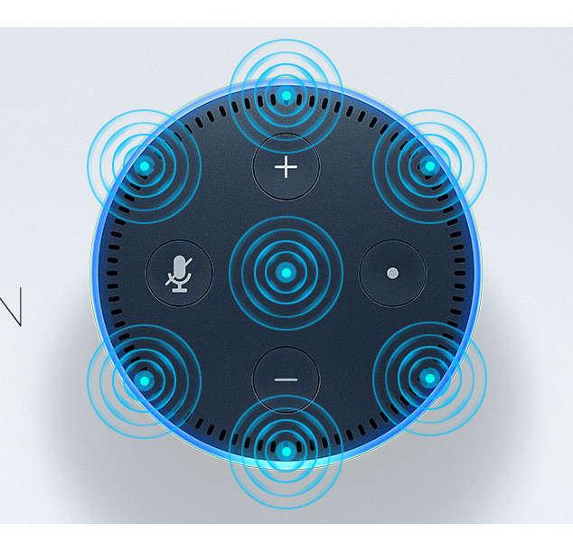
About Alexa
Alexa is a cloud-based voice-response system implemented on certain Amazon products and a variety of 3rd party products.
Amazon Echo, Echo Dot, Tap, Fire Stick, etc.
3rd Party products including car stereos, watches, audio systems, etc.
Open to developers to implement Alexa into their own products and services.
Alexa implements official and 3rd party “skills” which enhance the basic voice response system with applications.

Slide 5
About Alexa
Alexa opens the mic when the trigger word is spoken. This is usually Alexa, but can be changed to other words.
Once the trigger word is understood, the system will load a “skill” based on additional trigger words associated with the device.
The user has the option to load custom skills onto their device. This can be through services like Dominos or MSU’s “giving to” page. Currently there are thousands of 3rd party skills available.
Essentially, Alexa is a more extensible version of Google’s Now service, Apple’s Siri or Microsoft’s Cortana.

Slide 6
The basics of building an alexa skill

Slide 7
A few definitions
Know the following :
A Skill is an application associated with an Alexa-enabled device. A Skill is commonly hosted as an Amazon Lambda application, but it can be hosted via HTTPS as well.
An Intent is a destination of a phrase spoken to Alexa. For example, “Tell me a Joke”, “Tell me a Funny,” etc. would all go to a similar intent. A different intent may be “Tell me about a comedian”, which would have a different response.
An Utterance is the actual spoken phrase. You can have multiple utterances point to a single intent.
A Slot is a “fill in the blank” portion of an utterance. Think of it as a variable. For example, you might have “Tell me the weather in {CITY} today.” CITY would be the SLOT you are looking for and can act on.

Slide 8
Skill Types
There are three skill types you need to know about :
Custom Skill – This is a typical ‘conversational’ back and forth skill you are most familiar with. “Ask Dominos to order me a pizza.” or “Ask the ColdFusion User Group who the best programmer is.”
Smart Home Skill – This will interact with some sort of IoT device. “Turn the thermostat down two degrees” or “Turn on the front port light.”
Flash Briefing Skill – This is a skill that will be included in the “Flash Briefing” which is essentially a news roll. A user a can choose to have a skill included in the Flash Briefing. There is no interactivity in these skills.

Slide 9
Skill Deployments
Skills can be deployed in one of two ways :
Amazon Lambda Code : This is the preferred and easiest way to deploy an Alexa skills. It also requires the least amount of setup.
Only Java and NodeJS deployments possible.
No server to be hosted. Only requires an Amazon AWS account (on the free tier)
HTTPS Deployment : This is possible but requires some infrastructure
Requires a server running HTTPS/SSL on port 443 ONLY.
Requires a valid SSL certificate, even for testing.
Requires a server that can accept JSON POSTs. Must respond as JSON.
Code samples provided for NodeJS and Java. Can use any server that meets above requirements.

Slide 10
Getting Started
I will make the assumptions :
You have a server already setup and answering for HTTPS, with a valid cert.
You are using either ColdFusion or Lucee.
My setup involves:
A Lucee server (WAR deployment), running on Apache Tomcat and Apache httpd running on Amazon AWS.
An SSL certificate from LetsEncrypt
Firewall is set to allow https/http and SSH from campus. https from the world.

Slide 11
Code samples
https://github.com/quetwo/cfug-alexa-demo

Slide 12
Demo 1 – Super basic Demo
Explore CFML code
Alexa Developer Portal (http://developer.amazon.com/edw)
Deploy and check with Postman
Deploy and check developer portal
Check with actual device

Slide 13
Demo 2 – Support for slots
Add slot to intent
Read slot variables with CFML code
Update Utterances and Intent on developer portal

Slide 14
Demo 3 – Updating voice with SSML
Change text type with SSML
Play a response using SSML

Slide 15
Other things to know
In addition to voice responses, the Alexa framework also defines the use of “Cards”
Cards are bits of information that are given to the user in addition to the response.
These can show up in the Alexa app or other visual displays (such as the display on an Alexa watch).
They include a header, information blurb, image and a link.
Included in the “response” portion of the JSON response.

Slide 16
Having a Conversation
You can do more than simply do a single “turn” response. You can ask for more information.
By including the RePrompt JSON object, you can keep the session open. Include an outputspeech node to ask further questions.
Alexa will return a JSON request to your server with further responses. The user-id and sessionId will remain constant for further reprompts.
You will need to do your own session handling.

Slide 17
AudioPlayer
Another item at your disposal is to setup an AudioPlayer response.
Think of this as tuning into a radio station. You must accept commands to stop, pause and start streams to the device.
MP3 streaming is supported, with offsets.

Slide 18
JSON Reference
https://developer.amazon.com/public/solutions/alexa/alexa-skills-kit/docs/alexa-skills-kit-interface-reference

Slide 19
Q&A

Slide 20
Thanks!

